Slide 1

PROJECT CARD [SKIP IF FAMILIAR]
EASY
ADVANCED

Slide 2
INTRODUCTION AND KEY LEARNING OUTCOMES
We will an XG-Boost SageMaker Built-in algorithm using SageMaker JumpStart.
We will learn how to:
Train an XG-boost algorithm in SageMaker to predict university admission using AWS JumpStart
Train an XG-boost algorithm in SageMaker to predict life expectancy (capstone project) using AWS JumpStart
List XG-Boost hyperparameters
Assess trained regression models performance
Plot the residuals
Deploy an endpoint and perform inference

Slide 3

PROJECT CARD
GOAL:
Build, train, test and deploy a machine learning model to predict chances of university admission into a particular university given student’s profile.
TOOL:
AWS SageMaker Studio – Jump Start
PRACTICAL REAL-WORLD APPLICATION:
This project can be effectively used by university admission departments to determine top qualifying students.
DATA:
INPUTS (FEATURES):
GRE Scores (out of 340)
TOEFL Scores (out of 120)
University Rating (out of 5)
Statement of Purpose (SOP)
Letter of Recommendation (LOR) Strength (out of 5)
Undergraduate GPA (out of 10)
Research Experience (either 0 or 1)
OUTPUTS:
Chance of admission (ranging from 0 to 1)
Image Source: https://www.flickr.com/photos/pasa/6757993805
Dataset Source: https://www.kaggle.com/ljanjughazyan/cars1
Data Source: https://www.kaggle.com/mohansacharya/graduate-admissions
Photo Credit: https://www.pexels.com/photo/accomplishment-ceremony-education-graduation-267885/

Slide 4
JUMPSTART DEMO: OVERVIEW
EASY
ADVANCED

Slide 5
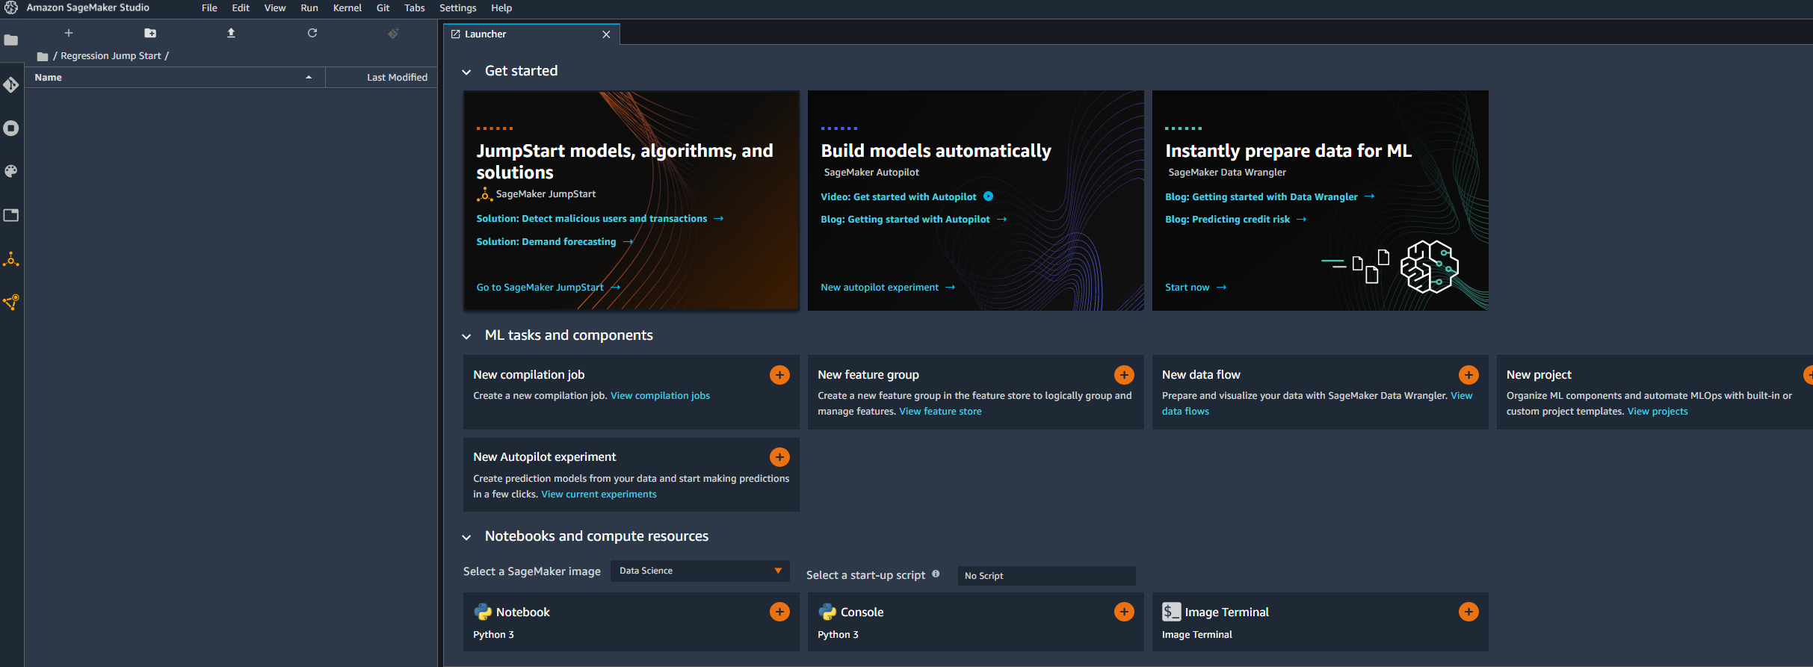
JUMP START DEMO
NAVIGATE TO AMAZON SAGEMAKER STUDIO HOMEPAGE AND CLICK ON SAGEMAKER JUMPSTART
Image Source: https://www.flickr.com/photos/pasa/6757993805
Dataset Source: https://www.kaggle.com/ljanjughazyan/cars1

Slide 6
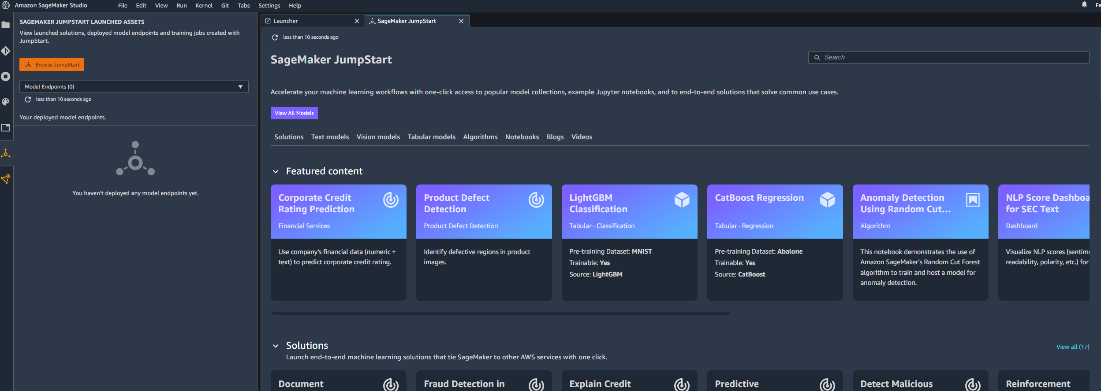
JUMP START DEMO
YOU SHOULD FIND SEVERAL ML WORKFLOWS THAT CAN BE DEPLOYED WITH ONE CLICK ACCESS. THERE ARE VISION, TEXT, AND TABULAR MODELS..ETC.
Image Source: https://www.flickr.com/photos/pasa/6757993805
Dataset Source: https://www.kaggle.com/ljanjughazyan/cars1

Slide 7
JUMPSTART DEMO: DATA PREP PRIOR TO TRAINING
EASY
ADVANCED

Slide 8
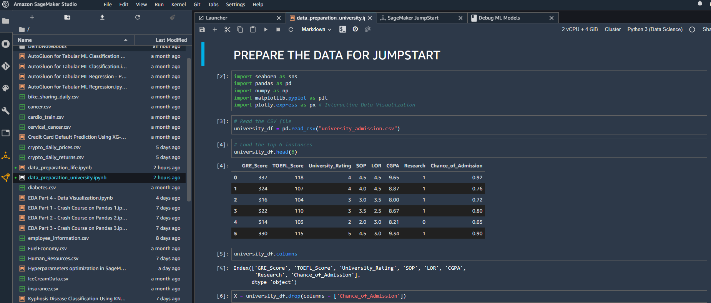
DATA PREP
IN THIS NOTEBOOK, WE WILL SPLIT THE DATA INTO TRAINING, VALIDATION AND TESTING. WE WILL ALSO SET THE FIRST COLUMN IN THE DATA TO BE OUR TARGET (OUTPUT) COLUMN.
Image Source: https://www.flickr.com/photos/pasa/6757993805
Dataset Source: https://www.kaggle.com/ljanjughazyan/cars1

Slide 9
JUMPSTART DEMO: DATA UPLOAD
EASY
ADVANCED

Slide 10
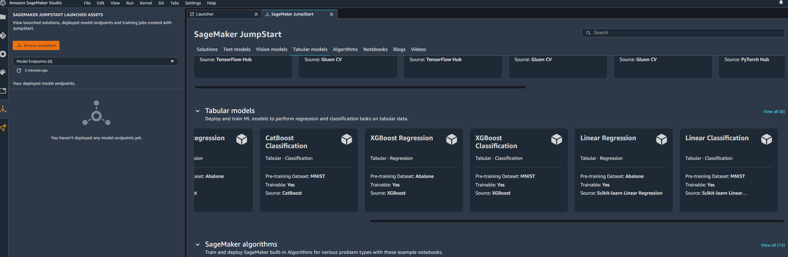
JUMP START DEMO
CLICK ON XGBOOST REGRESSION
Image Source: https://www.flickr.com/photos/pasa/6757993805
Dataset Source: https://www.kaggle.com/ljanjughazyan/cars1

Slide 11
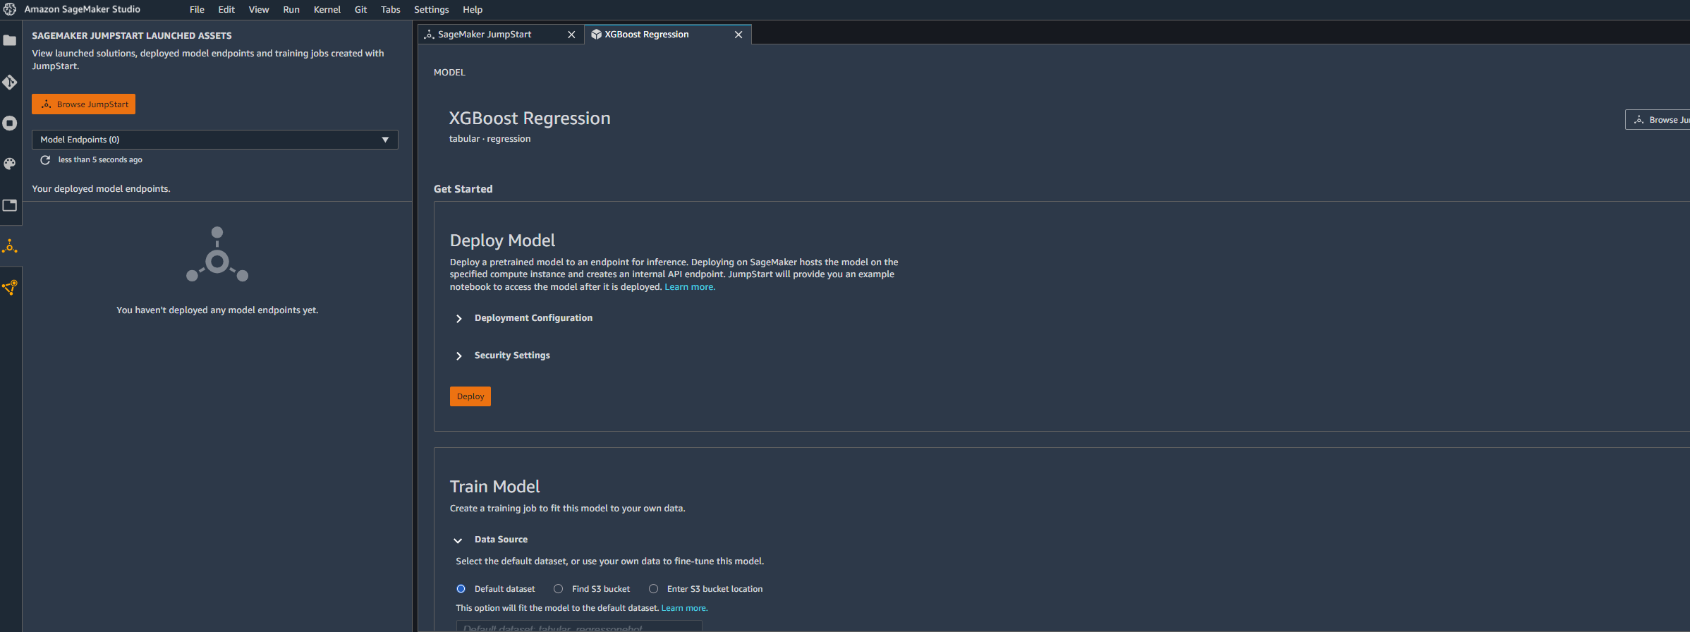
JUMP START DEMO
YOU CAN DEPLOY A PRETRAINED MODEL (MODEL TRAINED ON THE ABALONE DATASET) OR YOU CAN TRAIN THE MODEL WITH YOUR OWN CUSTOM DATASET
Image Source: https://www.flickr.com/photos/pasa/6757993805
Dataset Source: https://www.kaggle.com/ljanjughazyan/cars1

Slide 12
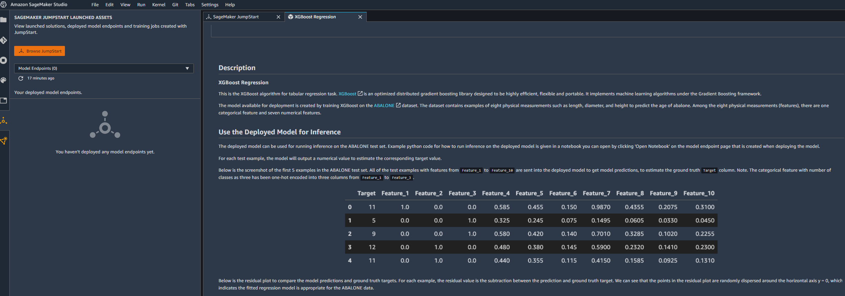
JUMP START DEMO
YOU CAN READ THE DESCRIPTION BELOW.
Image Source: https://www.flickr.com/photos/pasa/6757993805
Dataset Source: https://www.kaggle.com/ljanjughazyan/cars1

Slide 13
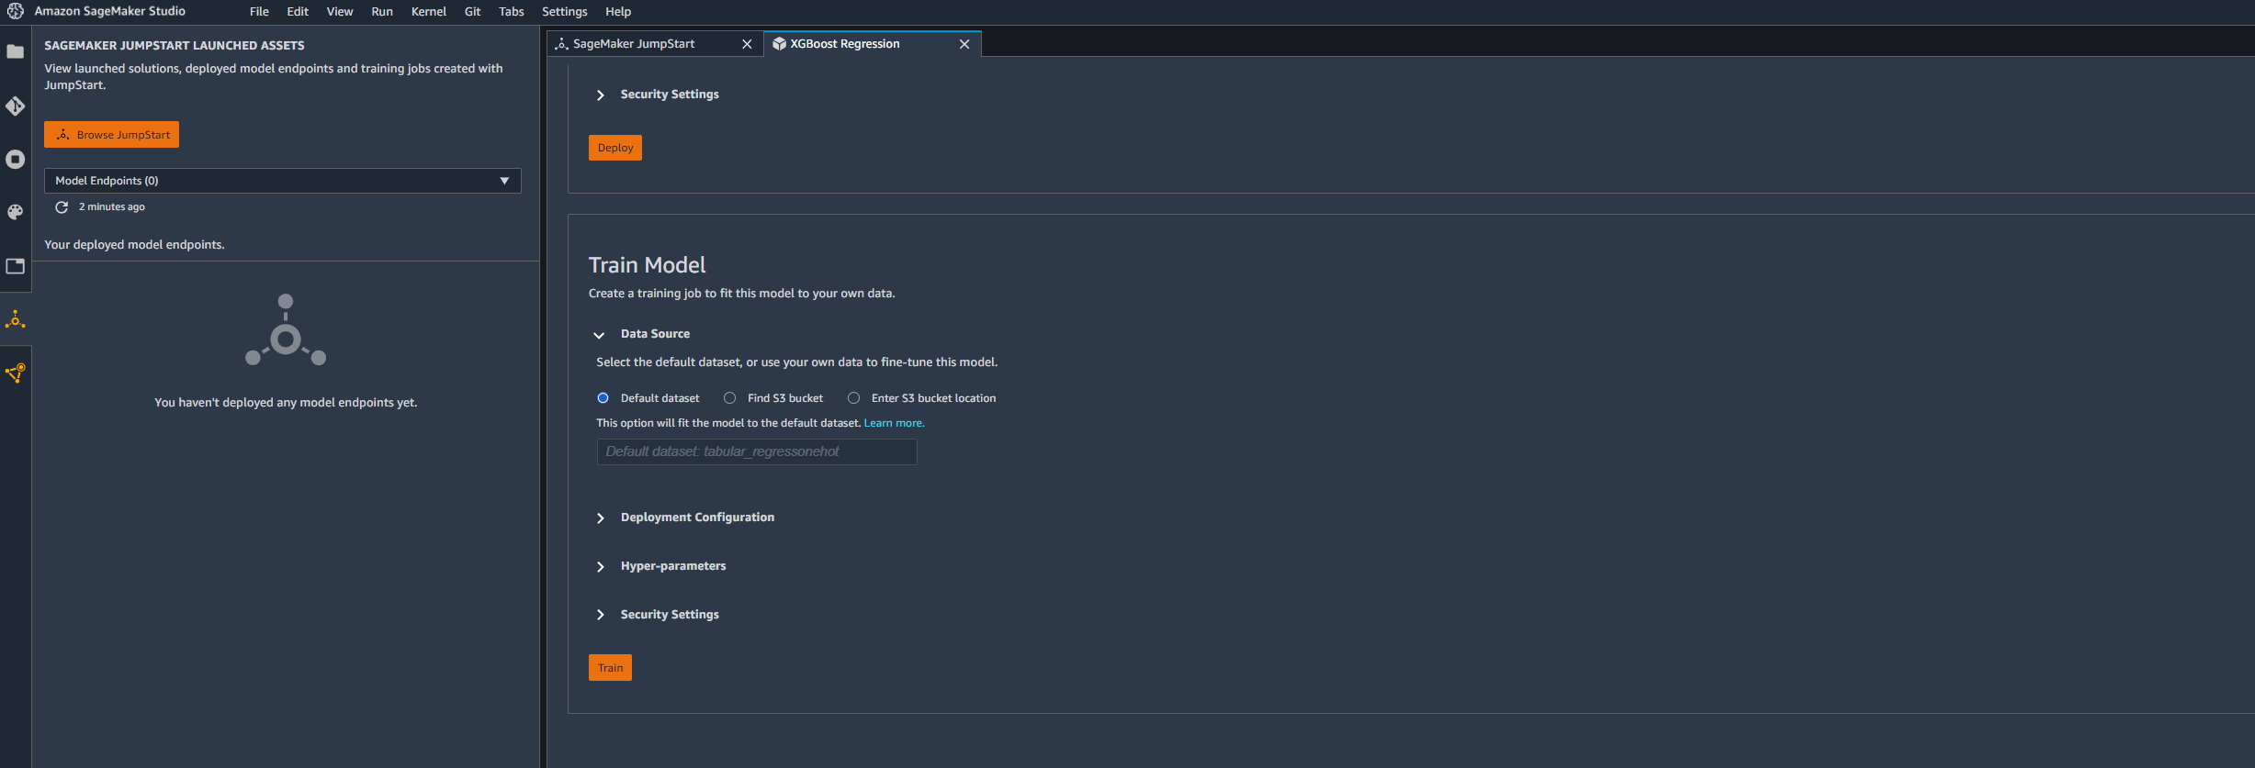
JUMP START DEMO
INPUT: A DIRECTORY CONTAINS 2 SUB-DIRECTORY 'TRAIN/' 'VALIDATION/’.
EACH SUB-DIRECTORY CONTAINS A 'DATA.CSV' FILE. THE 'DATA.CSV' FILES UNDER SUB-DIRECTORY 'TRAIN/' AND 'VALIDATION/' ARE FOR TRAINING/VALIDATION.
THE FIRST COLUMN OF THE 'DATA.CSV' SHOULD HAVE THE CORRESPONDING TARGET VARIABLE AND THE REST CONTAINS THE FEATURES.
YOU MUST ENCODE ALL CATEGORICAL FEATURES FIRST.
OUTPUT: A TRAINED MODEL THAT CAN BE DEPLOYED FOR INFERENCE.
Image Source: https://www.flickr.com/photos/pasa/6757993805
Dataset Source: https://www.kaggle.com/ljanjughazyan/cars1

Slide 14
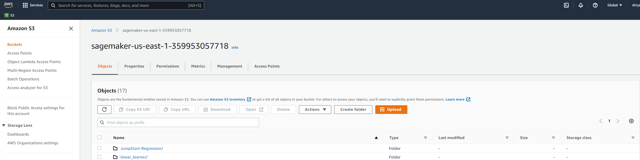
JUMP START DEMO
NAVIGATE TO S3, CREATE A DIRECTORY AND LIST THE TRAIN AND TEST DATASET
Image Source: https://www.flickr.com/photos/pasa/6757993805
Dataset Source: https://www.kaggle.com/ljanjughazyan/cars1

Slide 15
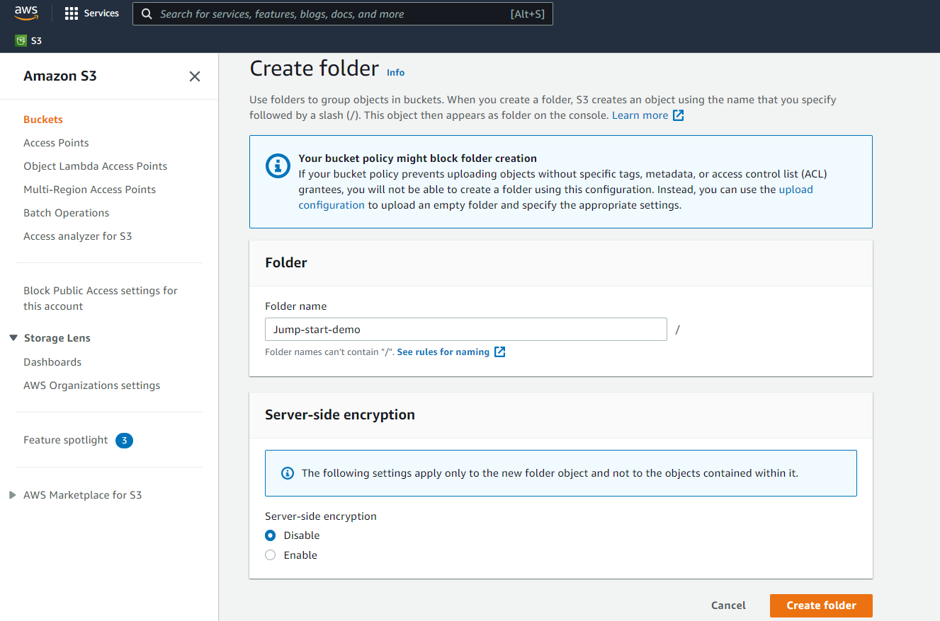
JUMP START DEMO
CREATE A NEW FOLDER IN THE DEFAULT SAGEMAKER BUCKET
Image Source: https://www.flickr.com/photos/pasa/6757993805
Dataset Source: https://www.kaggle.com/ljanjughazyan/cars1

Slide 16
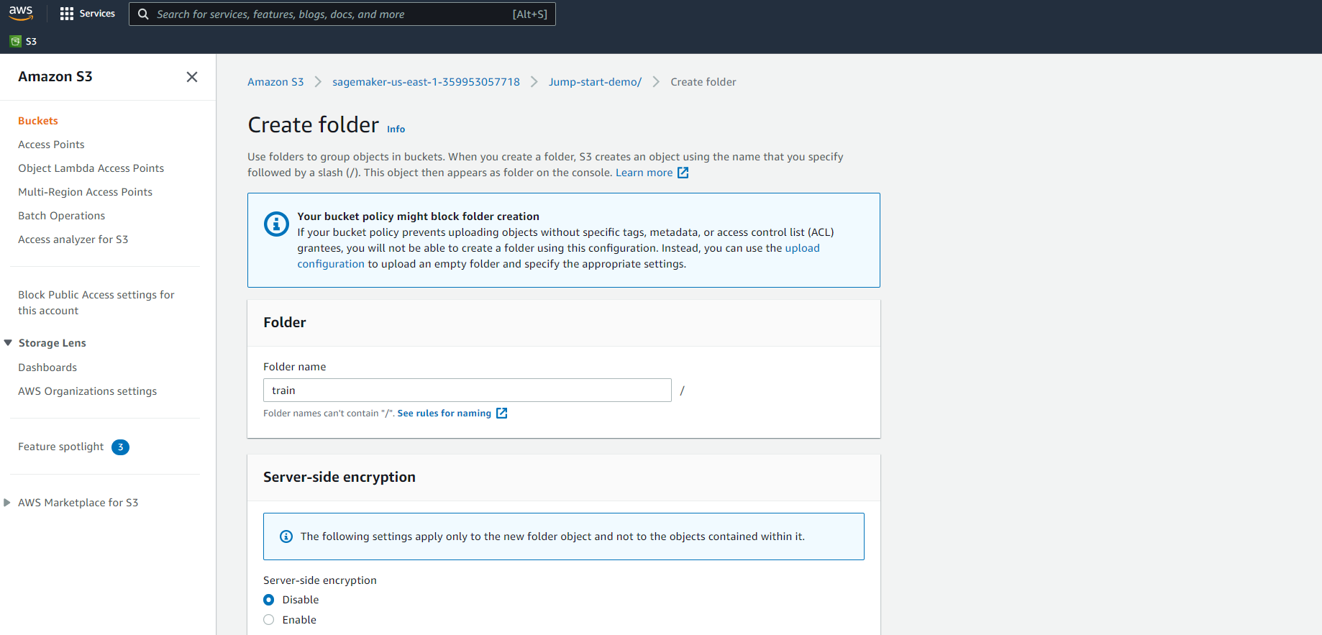
JUMP START DEMO
CREATE A SUB-DIRECTORY AND NAME IT TRAIN
Image Source: https://www.flickr.com/photos/pasa/6757993805
Dataset Source: https://www.kaggle.com/ljanjughazyan/cars1

Slide 17
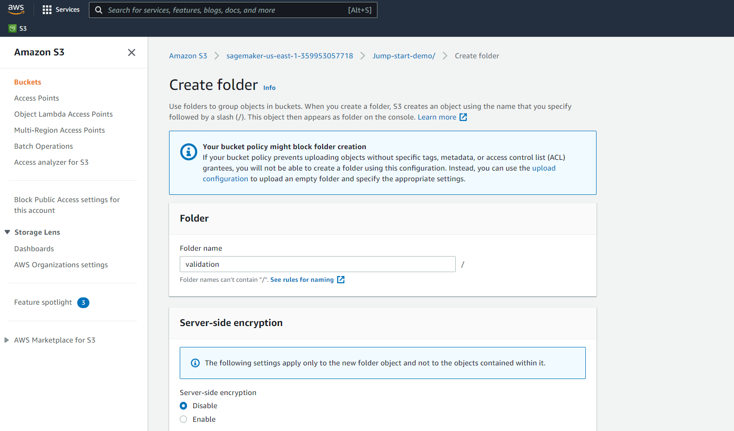
JUMP START DEMO
CREATE A SUB-DIRECTORY AND NAME IT VALIDATION
Image Source: https://www.flickr.com/photos/pasa/6757993805
Dataset Source: https://www.kaggle.com/ljanjughazyan/cars1

Slide 18
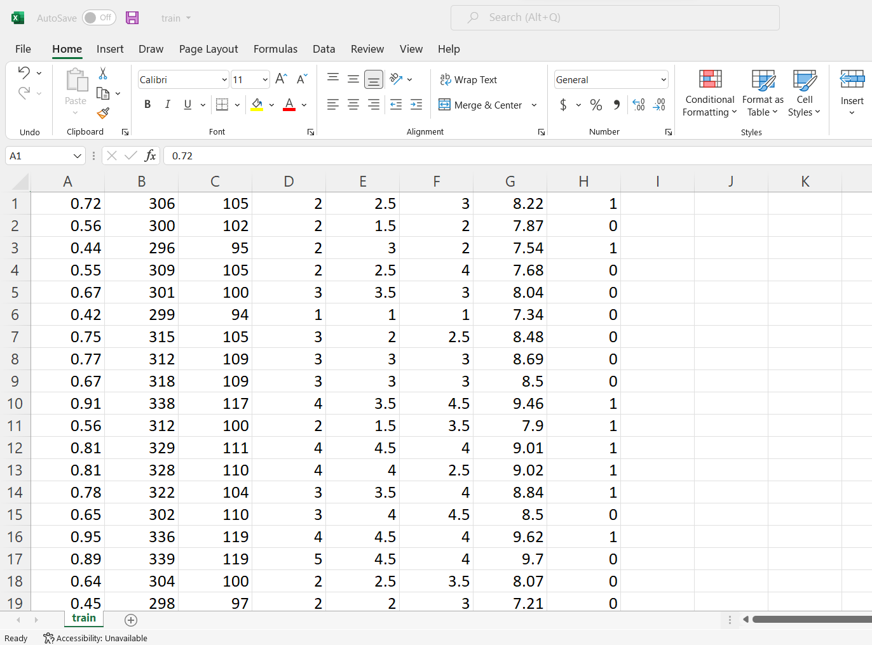
JUMP START DEMO
UPLOAD THE TRAINING DATASET TO TRAIN DIRECTORY. NOTE THAT THE FOLLOWING: (1) NO HEADERS, (2) TARGET VARIABLE IS LISTED FIRST, (3) YOU WILL NEED TO RENAME THE FILE TO DATA.CSV AFTER IT’S UPLOADED TO S3
Image Source: https://www.flickr.com/photos/pasa/6757993805
Dataset Source: https://www.kaggle.com/ljanjughazyan/cars1

Slide 19
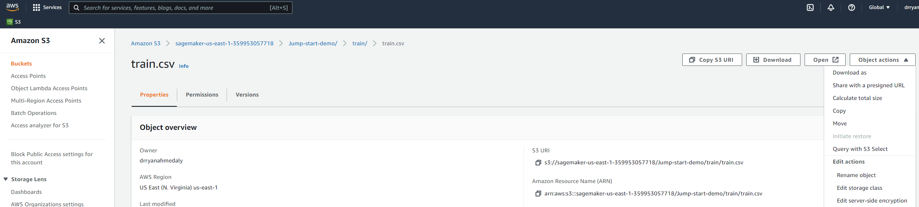
JUMP START DEMO
CLICK ON RENAME OBJECT
Image Source: https://www.flickr.com/photos/pasa/6757993805
Dataset Source: https://www.kaggle.com/ljanjughazyan/cars1

Slide 20
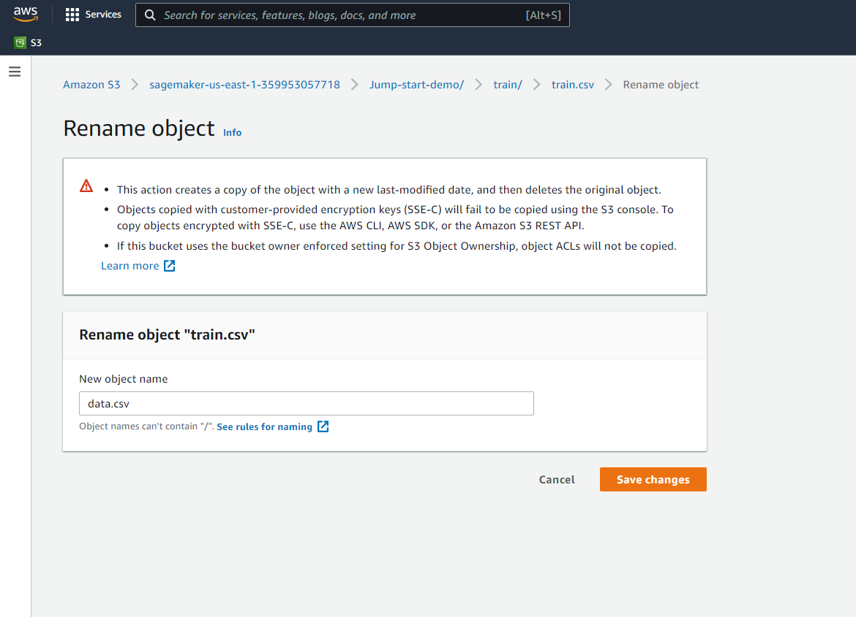
JUMP START DEMO
RENAMED IT FROM TRAIN.CSV TO DATA.CSV
Image Source: https://www.flickr.com/photos/pasa/6757993805
Dataset Source: https://www.kaggle.com/ljanjughazyan/cars1

Slide 21
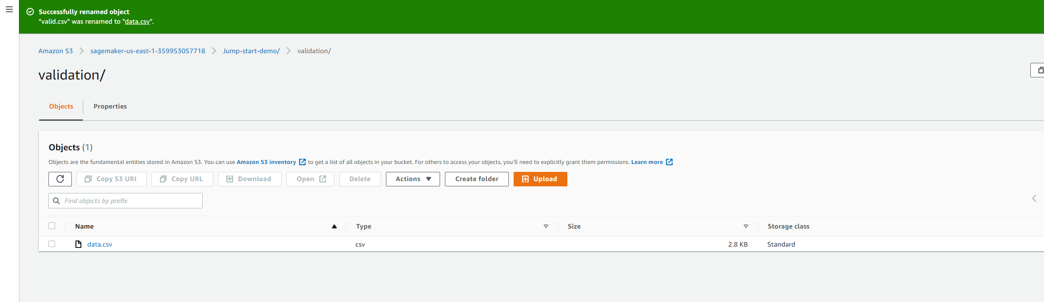
JUMP START DEMO
DO THE SAME FOR THE VALIDATION DATASET
Image Source: https://www.flickr.com/photos/pasa/6757993805
Dataset Source: https://www.kaggle.com/ljanjughazyan/cars1

Slide 22
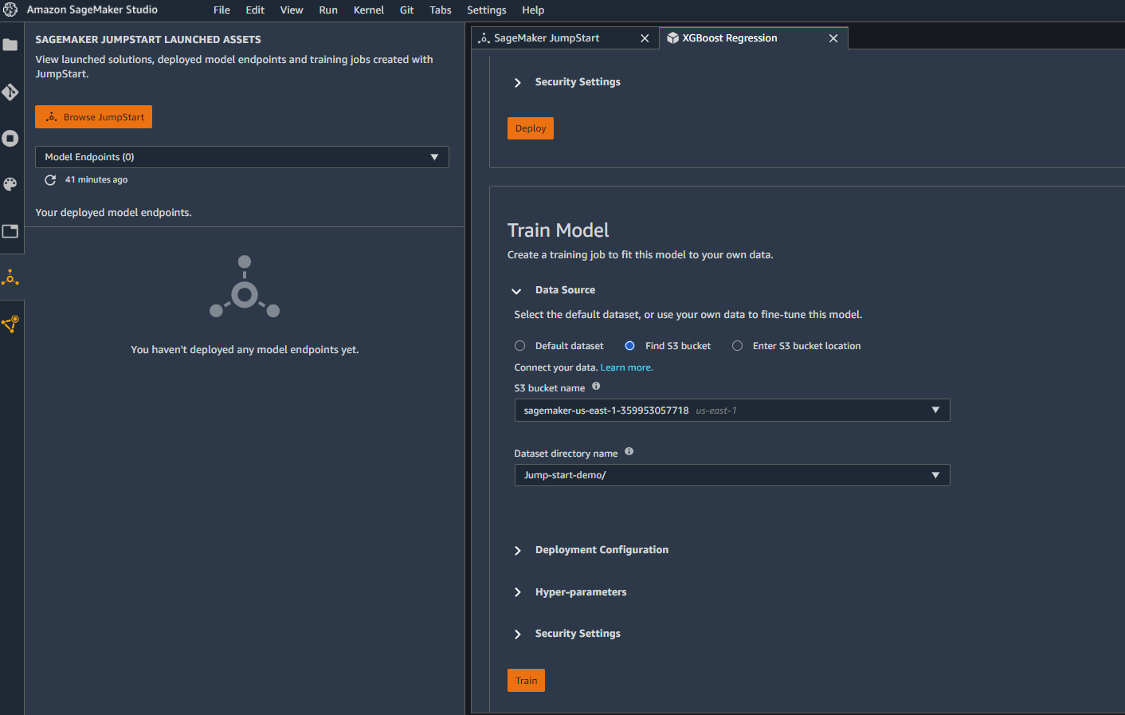
JUMP START DEMO
SELECT THE S3 BUCKET AND DATASET DIRECTORY NAME. GO AHEAD, CLICK TRAIN TO START THE TRAINING PROCESS
Image Source: https://www.flickr.com/photos/pasa/6757993805
Dataset Source: https://www.kaggle.com/ljanjughazyan/cars1

Slide 23
JUMPSTART DEMO: MODEL TRAINING
EASY
ADVANCED

Slide 24
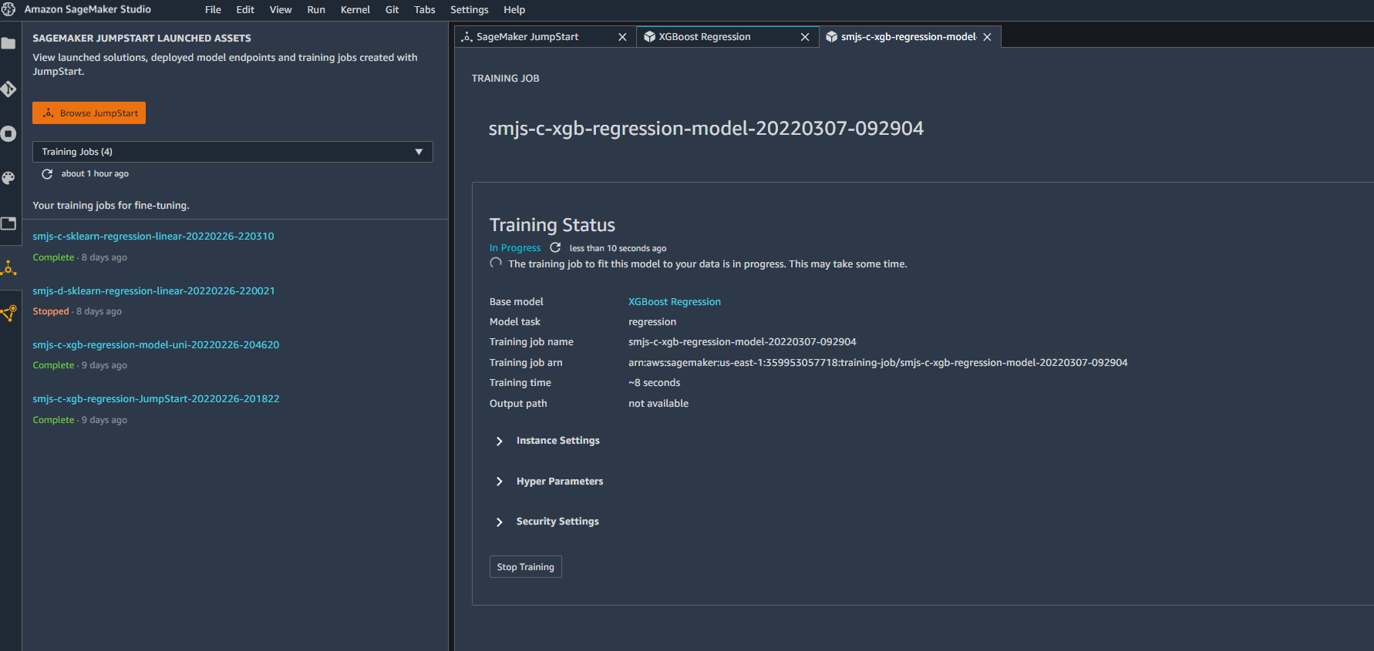
JUMP START DEMO
TRAINING PROCESS HAS JUST STARTED!
Image Source: https://www.flickr.com/photos/pasa/6757993805
Dataset Source: https://www.kaggle.com/ljanjughazyan/cars1

Slide 25
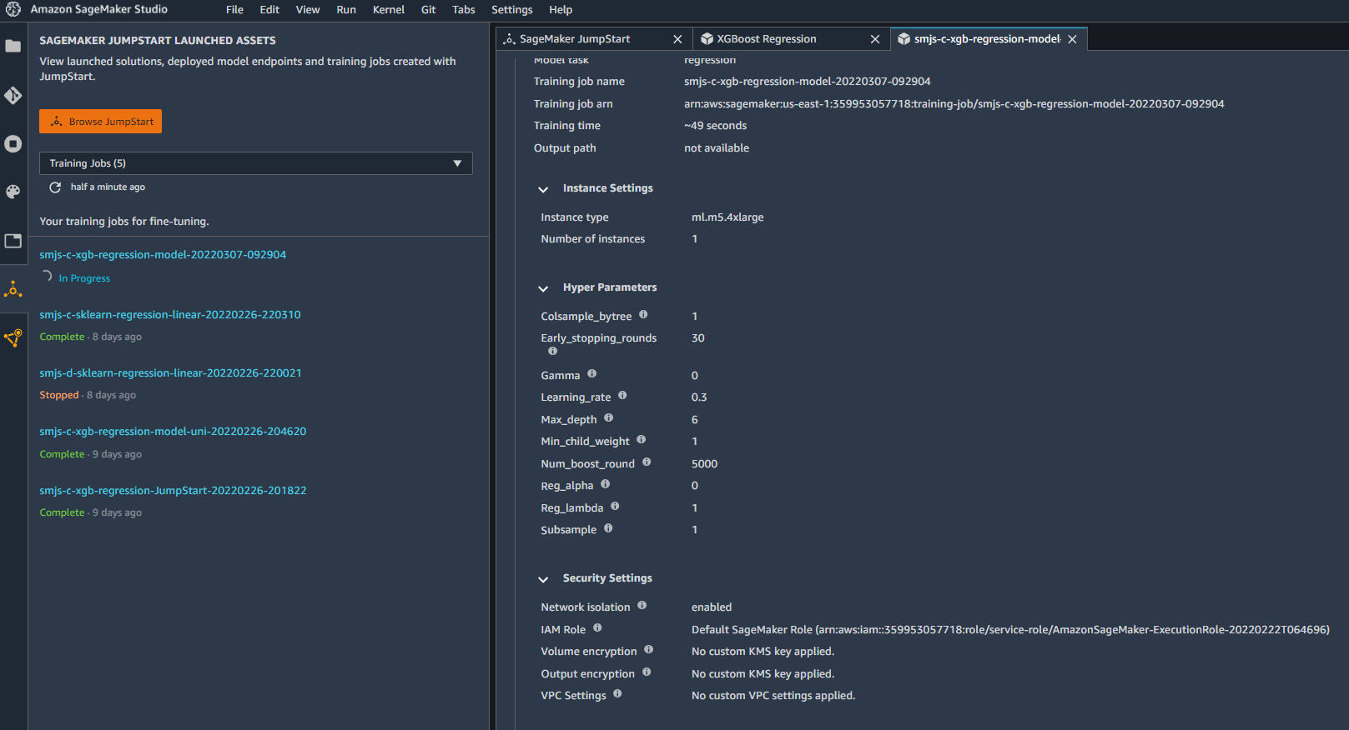
JUMP START DEMO
YOU CAN VIEW THE HYPERPARAMETERS AND INSTANCE SETTINGS
Image Source: https://www.flickr.com/photos/pasa/6757993805
Dataset Source: https://www.kaggle.com/ljanjughazyan/cars1

Slide 26
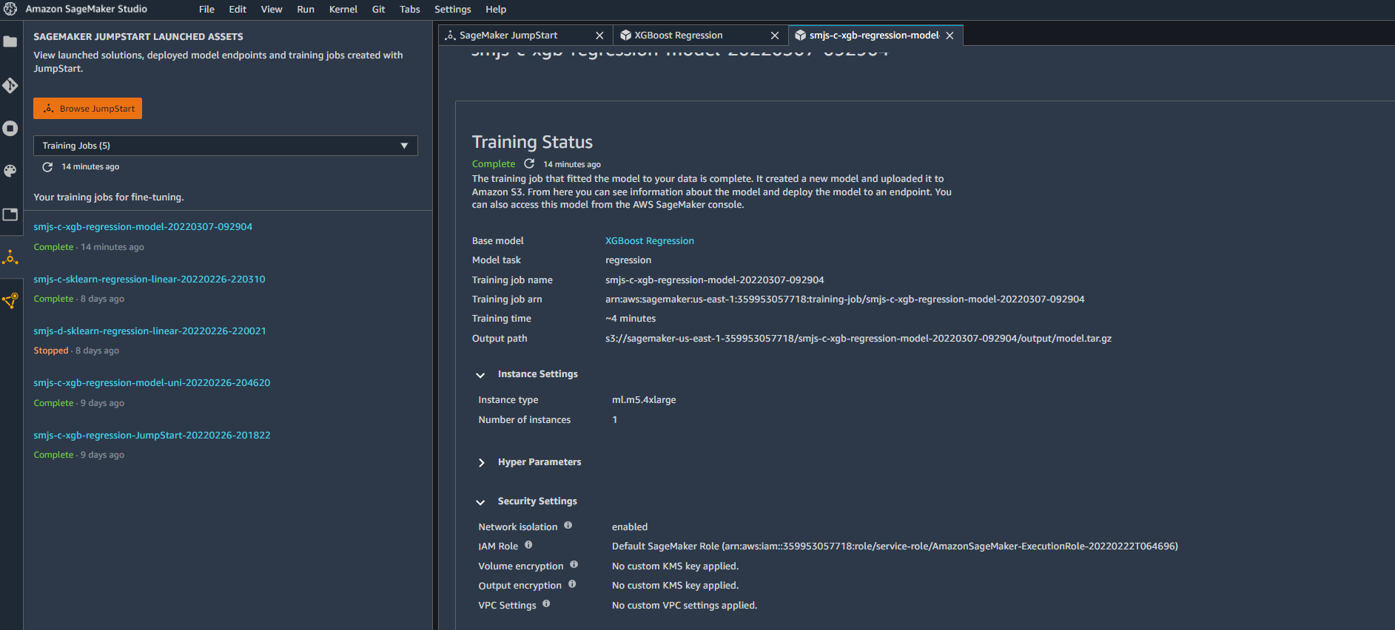
JUMP START DEMO
TRAINING IS NOW COMPLETE!
Image Source: https://www.flickr.com/photos/pasa/6757993805
Dataset Source: https://www.kaggle.com/ljanjughazyan/cars1

Slide 27
JUMPSTART DEMO: ENDPOINT DEPLOYMENT
EASY
ADVANCED

Slide 28
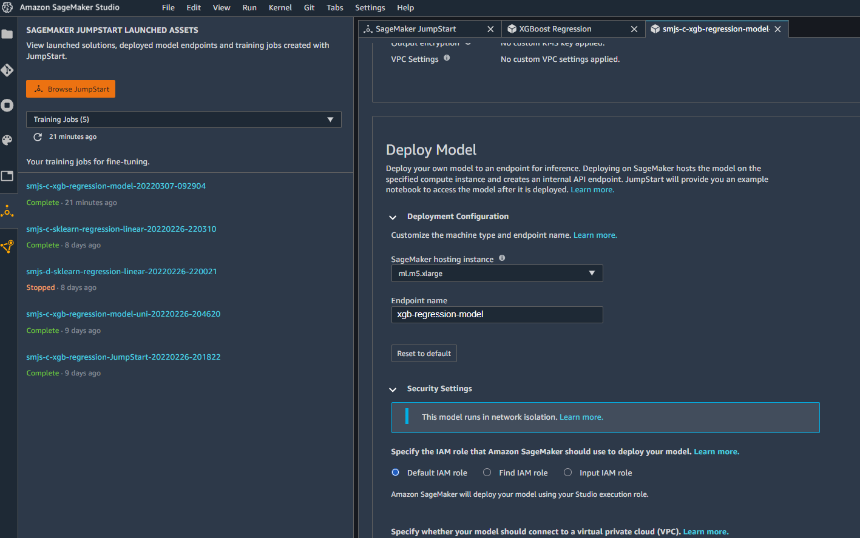
JUMP START DEMO
MODEL DEPLOYMENT
Image Source: https://www.flickr.com/photos/pasa/6757993805
Dataset Source: https://www.kaggle.com/ljanjughazyan/cars1

Slide 29
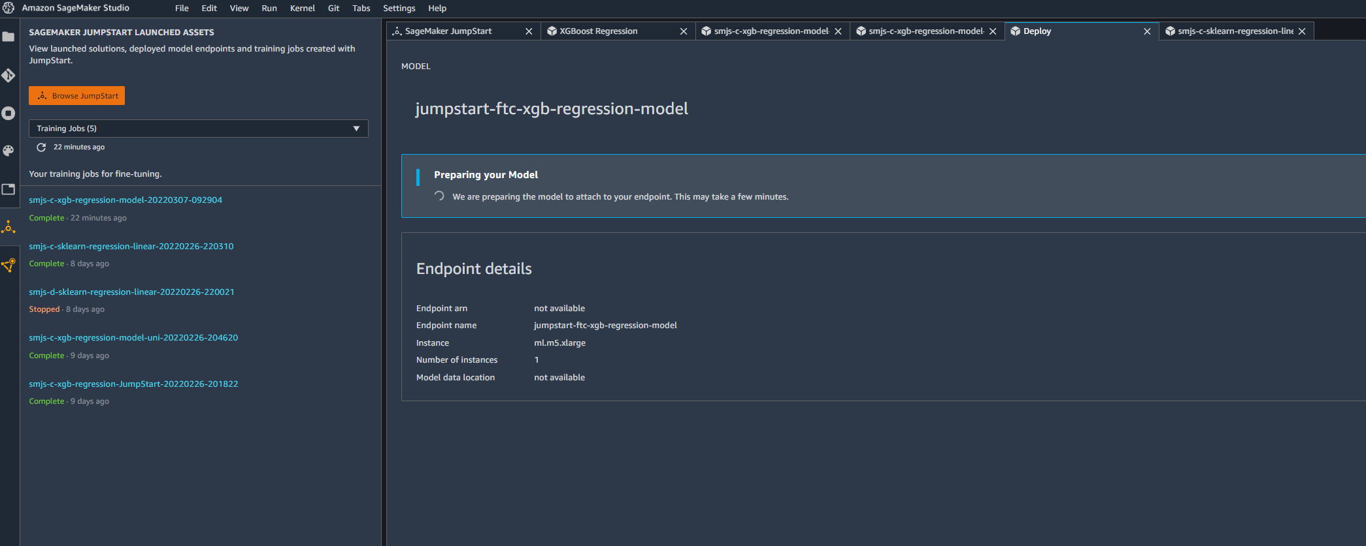
JUMP START DEMO
MODEL IS BEING DEPLOYED…THIS SHOULD TAKE COUPLE IF MINUTES.
Image Source: https://www.flickr.com/photos/pasa/6757993805
Dataset Source: https://www.kaggle.com/ljanjughazyan/cars1

Slide 30
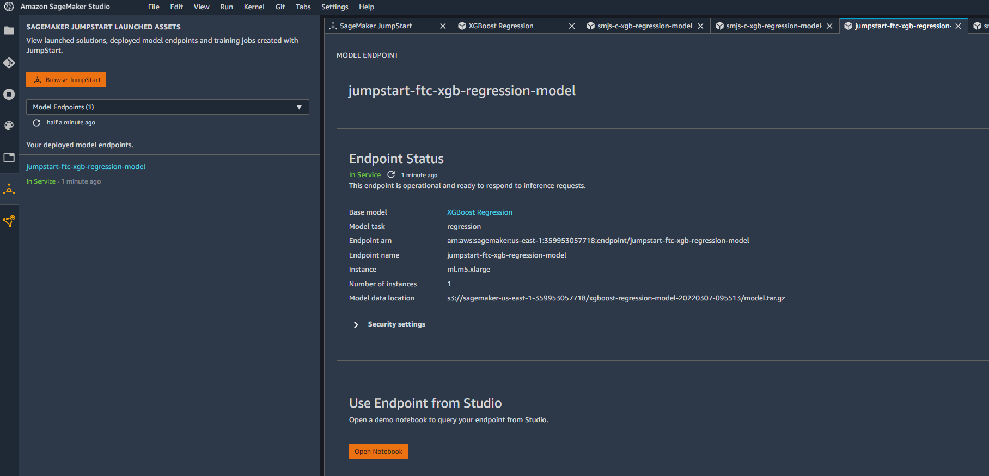
JUMP START DEMO
NOW THE ENDPOINT IS IN-SERVICE
Image Source: https://www.flickr.com/photos/pasa/6757993805
Dataset Source: https://www.kaggle.com/ljanjughazyan/cars1

Slide 31
JUMPSTART DEMO: INVOKE ENDPOINT
EASY
ADVANCED

Slide 32
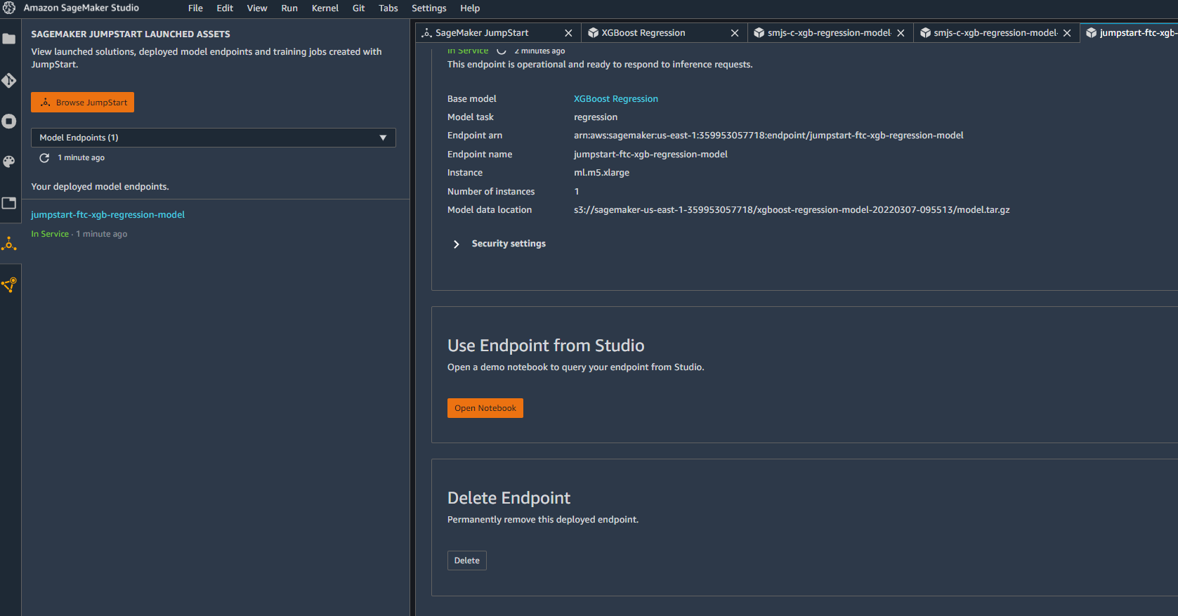
JUMP START DEMO
TO MAKE INFERENCE ON THE ENDPOINT, CLICK ON OPEN NOTEBOOK TO START MAKING QUERIES
Image Source: https://www.flickr.com/photos/pasa/6757993805
Dataset Source: https://www.kaggle.com/ljanjughazyan/cars1

Slide 33
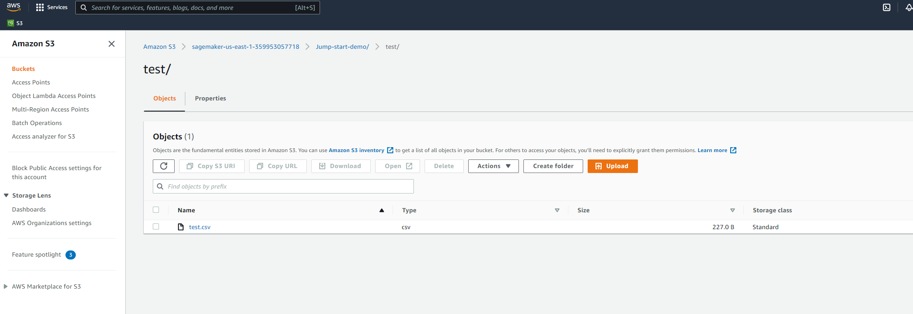
JUMP START DEMO
UPLOAD THE TESTING DATASETS TO THE S3 BUCKET
Image Source: https://www.flickr.com/photos/pasa/6757993805
Dataset Source: https://www.kaggle.com/ljanjughazyan/cars1

Slide 34
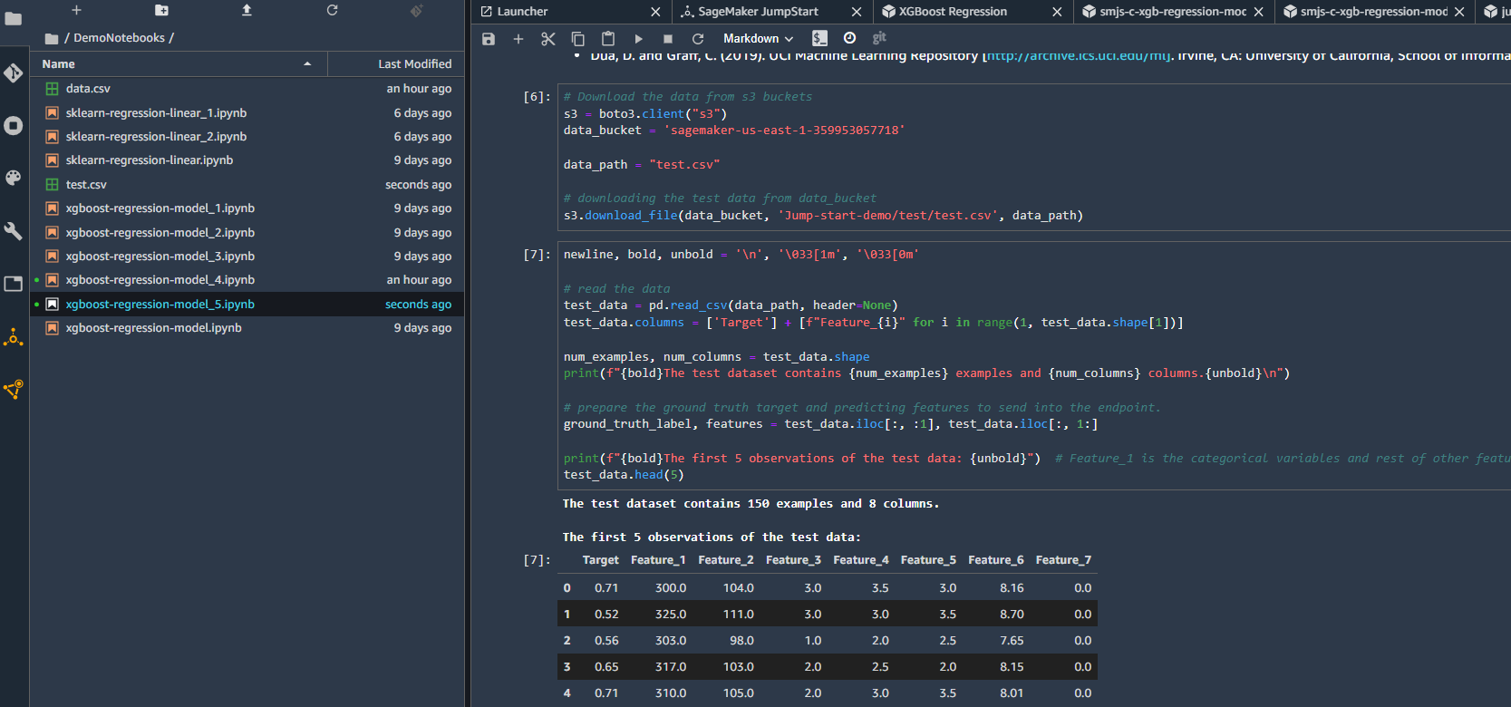
JUMP START DEMO
TO MAKE INFERENCE ON THE ENDPOINT, CLICK ON OPEN NOTEBOOK TO START MAKING QUERIES
Image Source: https://www.flickr.com/photos/pasa/6757993805
Dataset Source: https://www.kaggle.com/ljanjughazyan/cars1

Slide 35
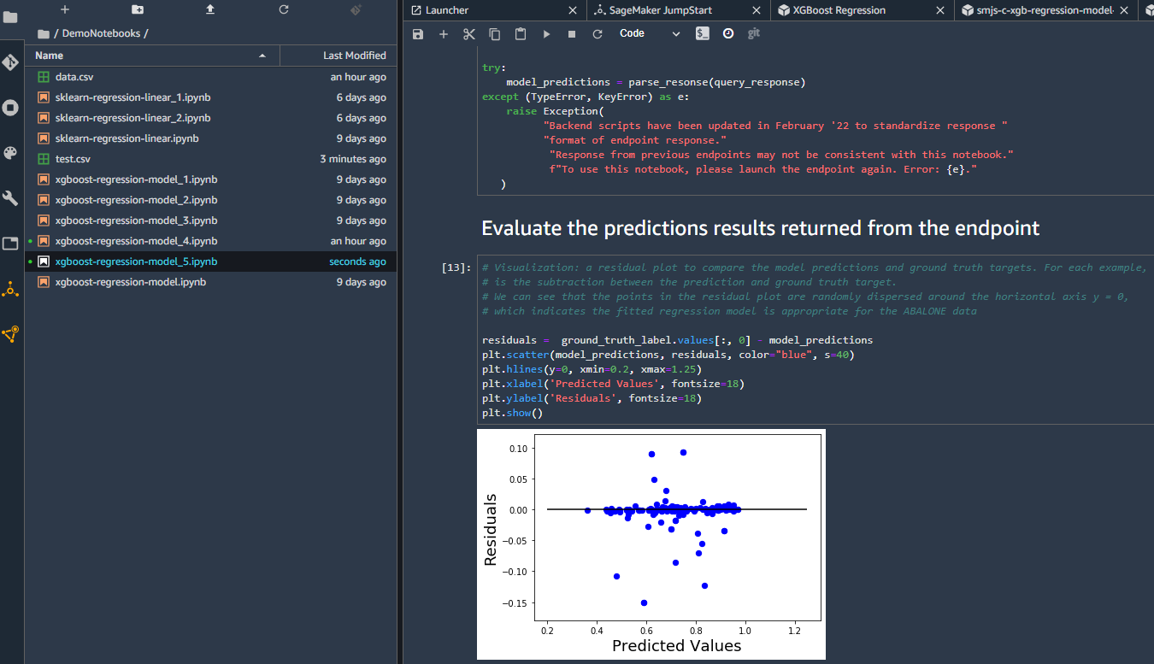
JUMP START DEMO
ASSESS TRAINED MODEL PERFORMANCE
Image Source: https://www.flickr.com/photos/pasa/6757993805
Dataset Source: https://www.kaggle.com/ljanjughazyan/cars1

Slide 36
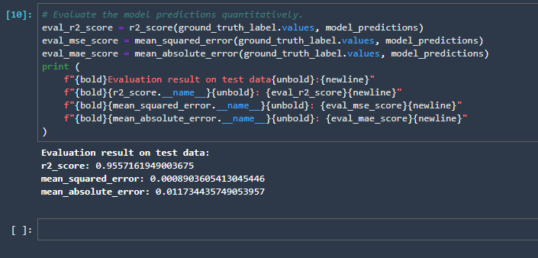
JUMP START DEMO
PRINT OUT REGRESSION MODELS EVALUATION METRICS
Image Source: https://www.flickr.com/photos/pasa/6757993805
Dataset Source: https://www.kaggle.com/ljanjughazyan/cars1

Slide 37
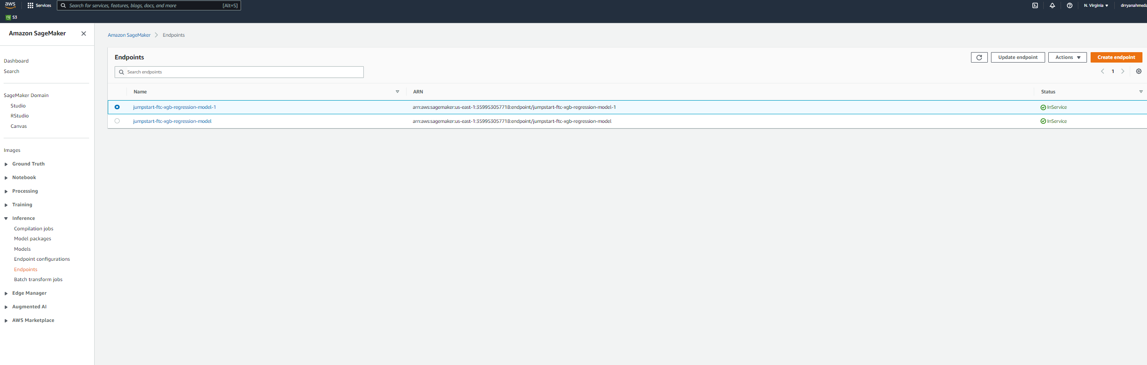
JUMP START DEMO
MAKE SURE TO DELETE THE DEPLOYED ENDPOINT AND SHUT DOWN ALL RUNNING INSTANCES
Image Source: https://www.flickr.com/photos/pasa/6757993805
Dataset Source: https://www.kaggle.com/ljanjughazyan/cars1

Slide 38
FINAL END-OF-DAY CAPSTONE PROJECT
EASY
ADVANCED

Slide 39
PROJECT OVERVIEW: SAGEMAKER JUMPSTART
In this hands-on project, we will train an XG-Boost Regression model to predict life expectancy using SageMaker Jumpstart.
This data was initially obtained from World Health Organization (WHO) and United Nations Website. Data contains features like year, status, life expectancy, adult mortality, infant deaths, percentage of expenditure, alcohol etc.
Tasks:
Upload the dataset Life_Expectancy_test_NoHeader.csv and Life_Expectancy_train_NoHeader.csv to S3
Using AWS SageMaker JumpStart, train an XG-Boost model to predict life expectancy.
Deploy the model and assess its performance. What’s R2?
INPUT FEATURES
PREDICTION
YEAR
ADULT MORTALITY
STATUS
INFANT DEATHS
ALCOHOL
HEPATITIS B
XG-BOOST MODEL
LIFE EXPECTANCY
Source: https://www.kaggle.com/jkumarajarshi/life-expectancy-who

Slide 40
FINAL END-OF-DAY CAPSTONE PROJECT SOLUTION
EASY
ADVANCED

Slide 41
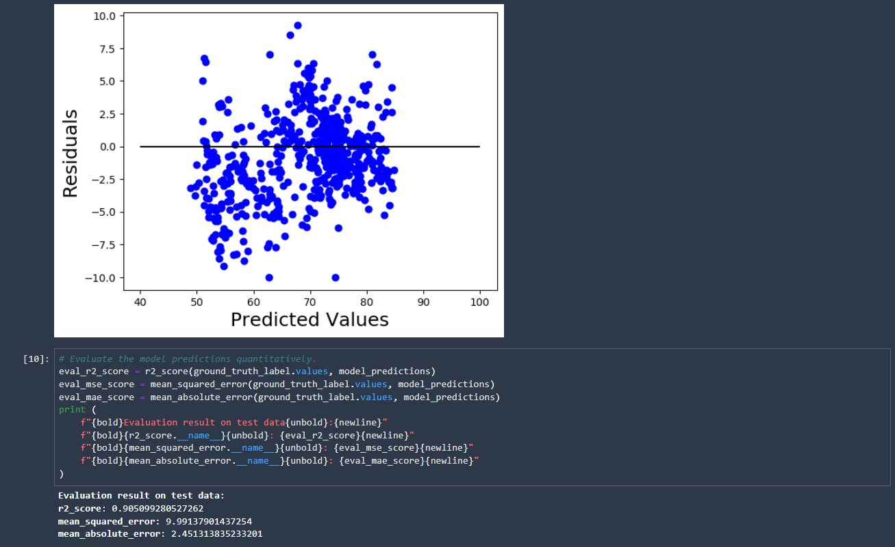
FINAL PROJECT SOLUTION
Image Source: https://www.flickr.com/photos/pasa/6757993805
Dataset Source: https://www.kaggle.com/ljanjughazyan/cars1

Slide 42
FINAL PROJECT SOLUTION
MAKE SURE TO DELETE THE DEPLOYED ENDPOINT AND SHUT DOWN ALL RUNNING INSTANCES
Image Source: https://www.flickr.com/photos/pasa/6757993805
Dataset Source: https://www.kaggle.com/ljanjughazyan/cars1

